Slide 1
World Wildlife Fund

Slide 2
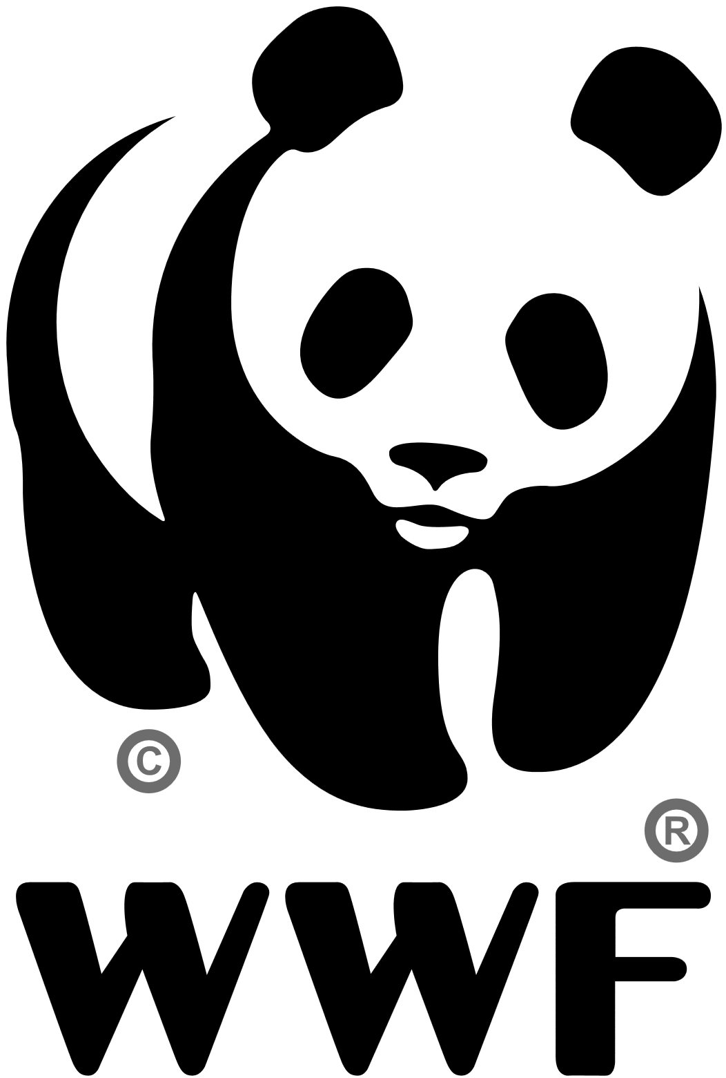
About WWF(World Wildlife Fund)
Name of organization?
[1]
Founder? When?
What do they do?
How do they help?
How can I help?
Logo for the World Wide Fund for Nature or WWF

Slide 3
Name of organization
The World Wildlife Fund
(WWF, also known abroad as World Wide Fund for Nature)
[1]

Slide 4
Founder? When?
WWF was established in 1961 by a group of passionate and
committed individuals who sought to secure the funding necessary
to protect places and species that were threatened by human development.
[2]

Slide 5
Founder? When?
The World Wildlife Fund is an international non-governmental organization working in 100
countries around the world in the field of wilderness preservation, and the reduction of
humanity’s footprint on the environment. Victor Stolan, reportedly inspired by newspaper
articles written by Julian Huxley in the United Kingdom, claimed there was a need for the
creation of an international organization to raise money for conservation efforts. The
director-general of British government agency Nature Conservancy, Max Nicholson, drafted
a plan in 1961 to assist the International Union for Conservation of Nature (IUCN) with
funding initiatives. The plan became the basis of the WWF.
[2]

Slide 6
What do they do?
[3]
Our vision is to build a future in which people live in harmony with nature.
To deliver this mission, we work to conserve and restore biodiversity,
the web that supports all life on Earth;
to reduce humanity’s environmental footprint;
and to ensure the sustainable use of natural resources to support current
and future generations.
[3]

Slide 7
How do they do help？
WWF takes an innovative, collaborative, science-based approach to achieve
its twin goals of saving biodiversity and reducing humanity's ecological footprint.
We focus our efforts.
We tackle the causes.
We capitalize on our expertise.
We build strong partnerships.
[4]

Slide 8
How can I help?
Measure your footprint
Climate change is one of the biggest threats to people and nature.
Find out how to reduce your impact.
Donate to WWF
Every day, all around the world, we're working to protect our amazing world.
Make a donation today.
Give to the climate crisis fund
Climate change has left our world in crisis, and our natural habitats under threat like
never before. We know what we need to do to change this – but we need your help.
......
[5]

Slide 9
How can I help?
Call of the Wild Podcast
Listen now to Series 2 of our podcast with WWF ambassador, Cel Spellman, with a
new episode available every two weeks. In each episode, Cel meets a special guest
and a top nature expert to dig deeper into the threats we’re facing and what each
of us can do to help.
Sustainable recipes
......
[5]

Slide 10
Biliography
[1] 2022 InfluenceWatch. “World Wildlife Fund” influencewatch.
https://www.influencewatch.org/non-profit/world-wildlife-fund/?msclkid=1cbc3f5cc49311ecb070b96f85c946c8. Accessed: 27 April, 2022.
[2] 2022 World Wildlife Fund. WWF. “History | WWF” worldwildlife.
https://www.worldwildlife.org/about/history. Accessed: 27 April, 2022.
[3] 2022 World Wildlife Fund. WWF. “Our Value | Pages | WWF”worldwildlife.
https://www.worldwildlife.org/pages/our-values. Accessed: 27 April, 2022.
[4] 2020 WWF - World Wide Fund For Nature. “How does WWF work? | WWF”
https://wwf.panda.org/_/how_we_work/. Accessed: 27 April, 2022.
[5] WWF-UK. “What Can I Do? | WWF” wwf.org.uk.
https://www.wwf.org.uk/what-can-i-do. Accessed: 27 April, 2022.

